Slide 1
Install SQL Server Reporting Services
Lecturer: Ngo Huy Bien
Software Engineering Department
Faculty of Information Technology
VNUHCM - University of Science
Ho Chi Minh City, Vietnam
nhbien@fit.hcmus.edu.vn

Slide 2

Objectives

Slide 3

Contents

Slide 4

References
Brian Larson (2017). Microsoft SQL Server 2016 Reporting Services. McGraw-Hill Education.

Slide 5
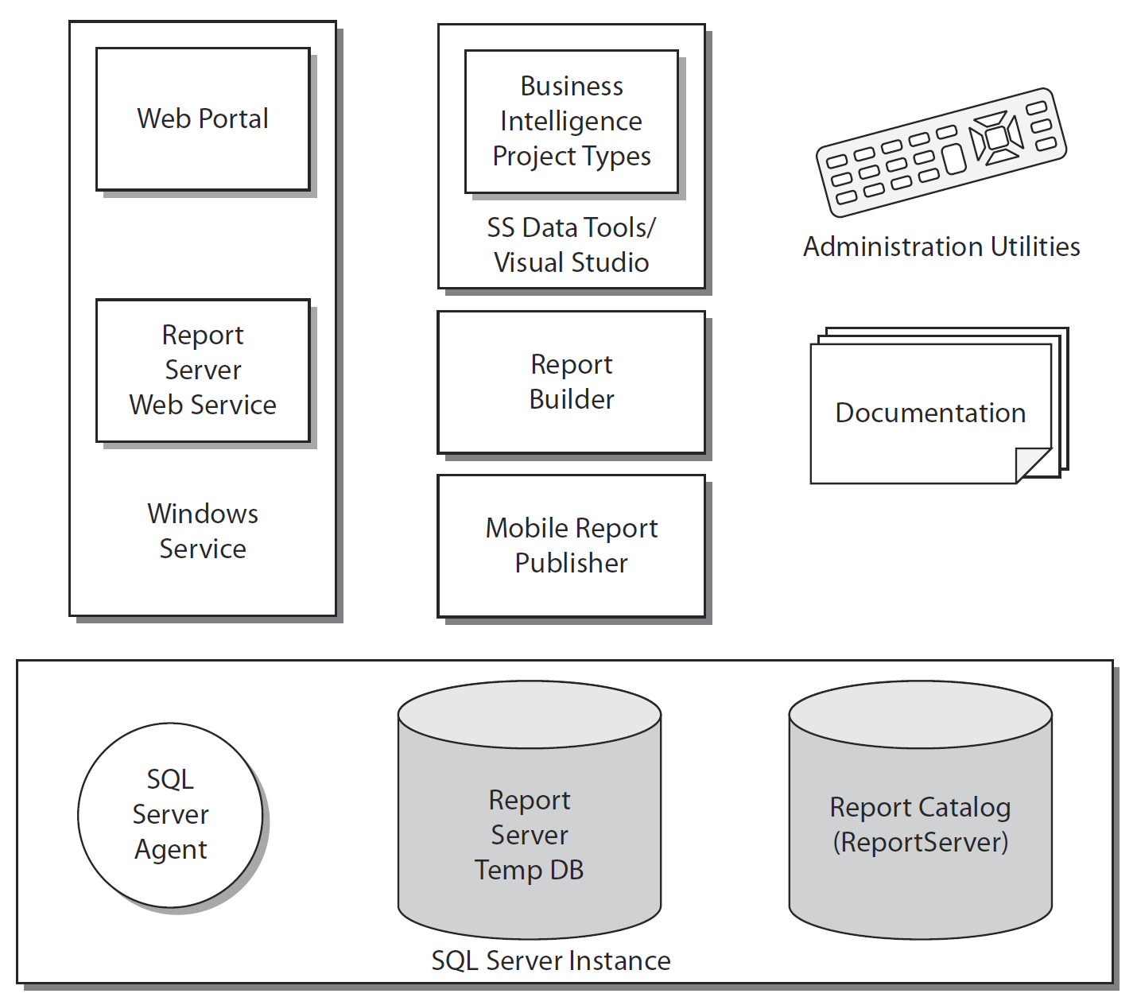
Reporting Services Components [1]

Slide 6
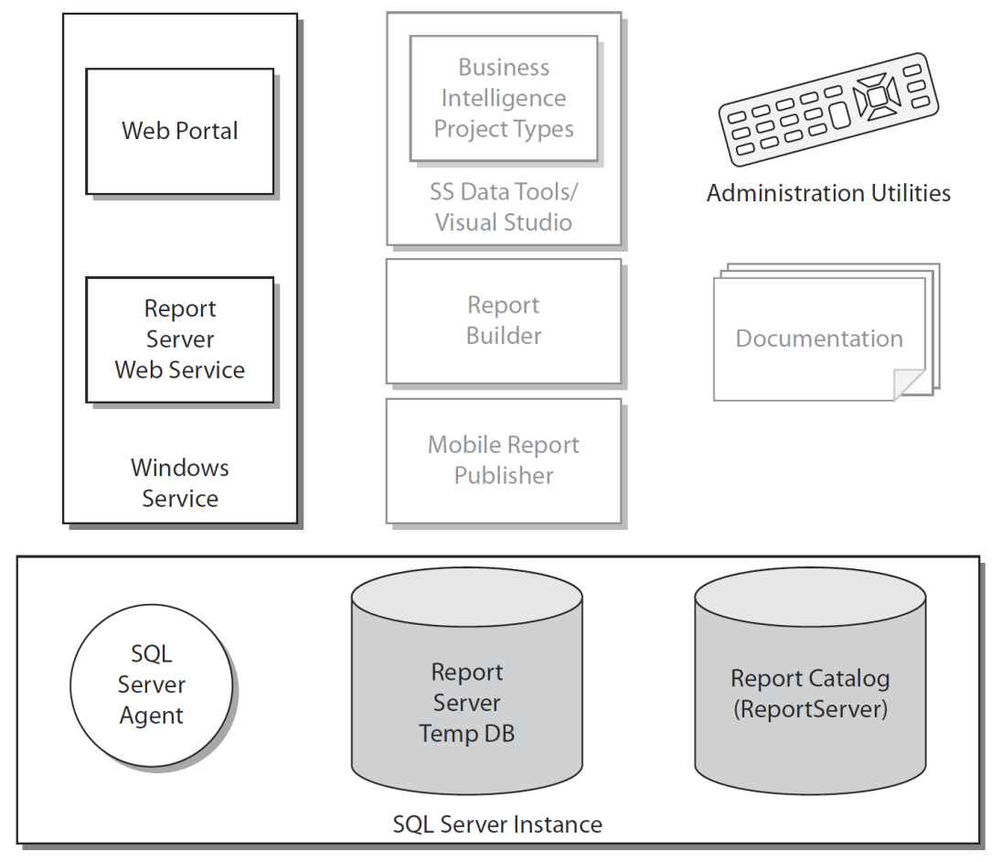
The Server Installation

Slide 7
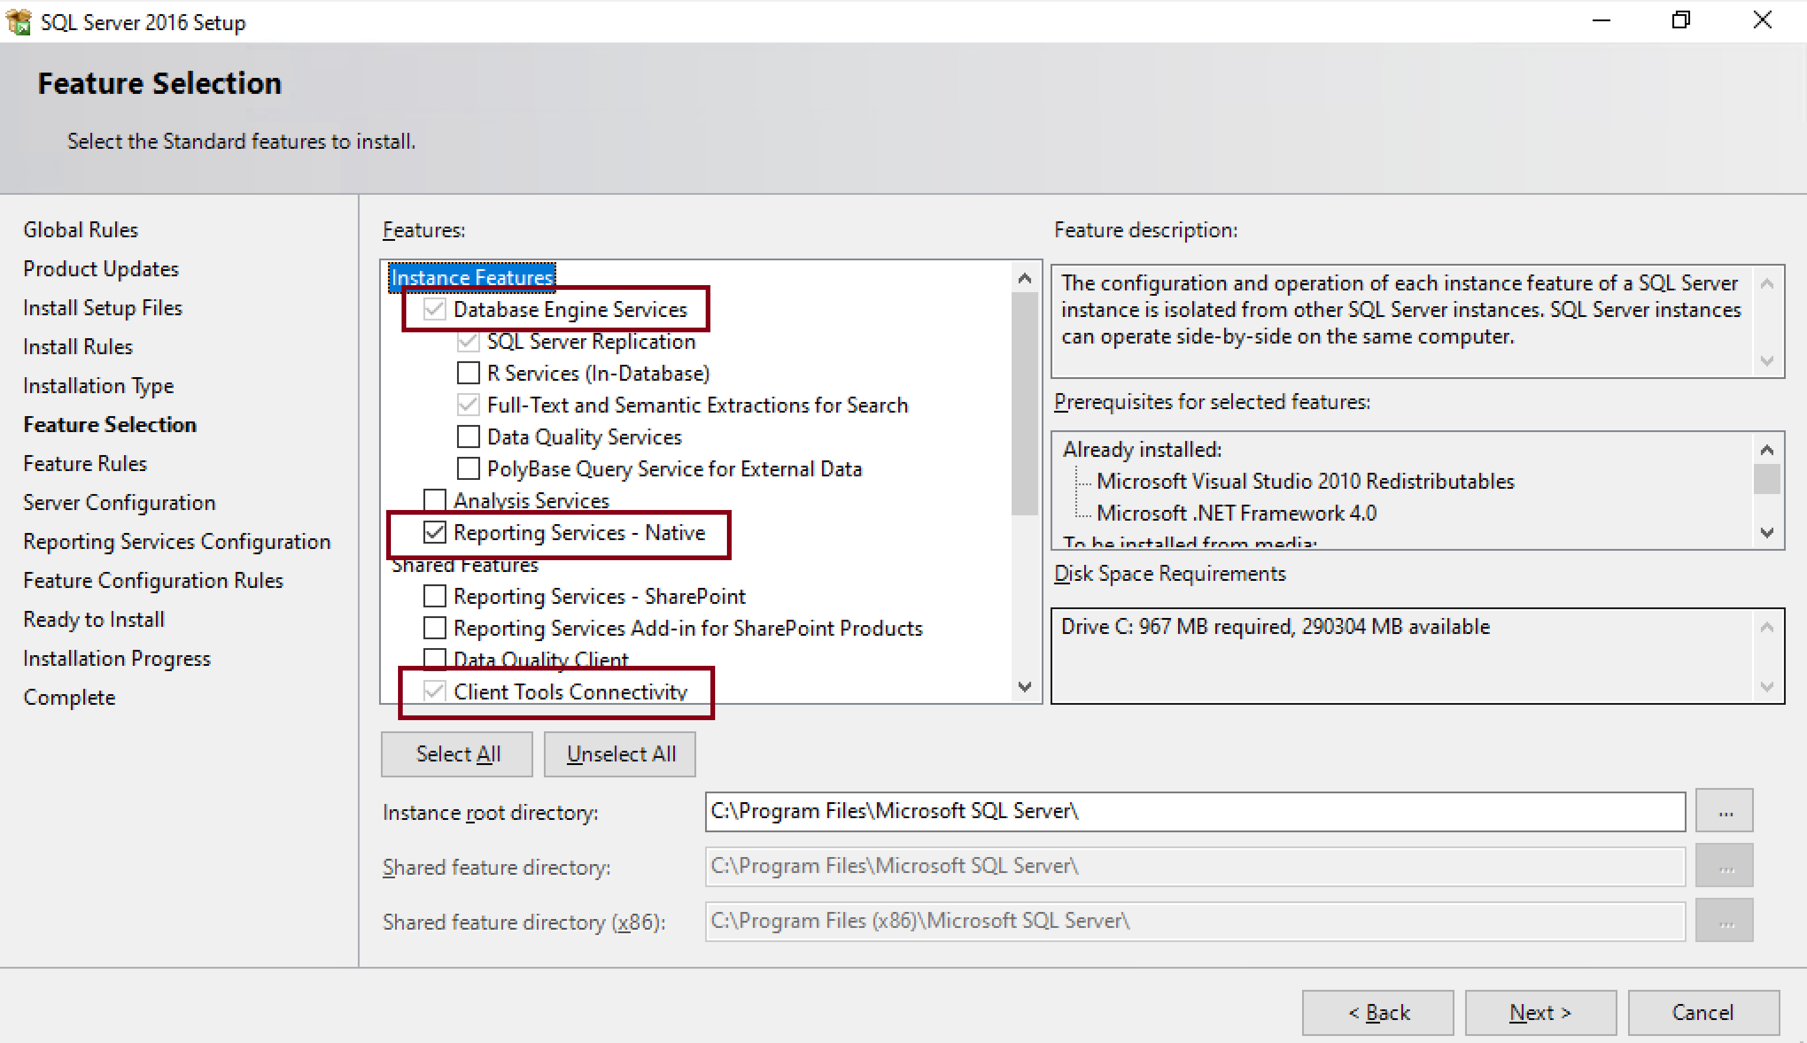
1. Install Reporting Services

Slide 8
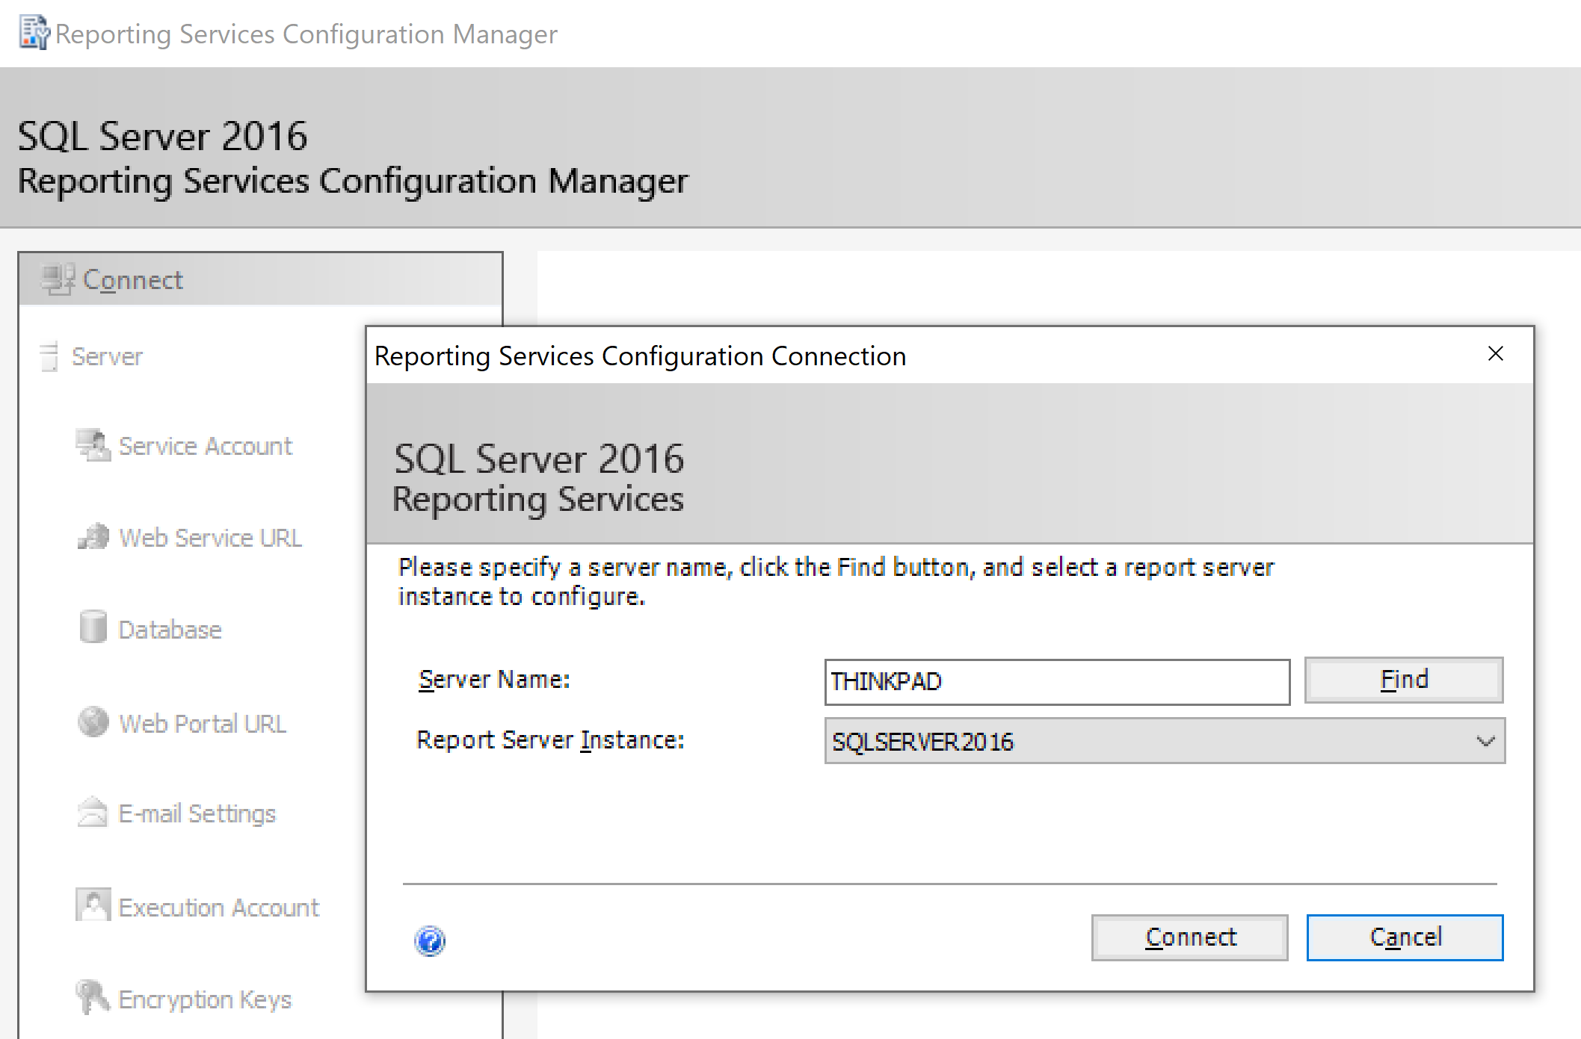
2. Open Reporting Services Configuration Manager

Slide 9
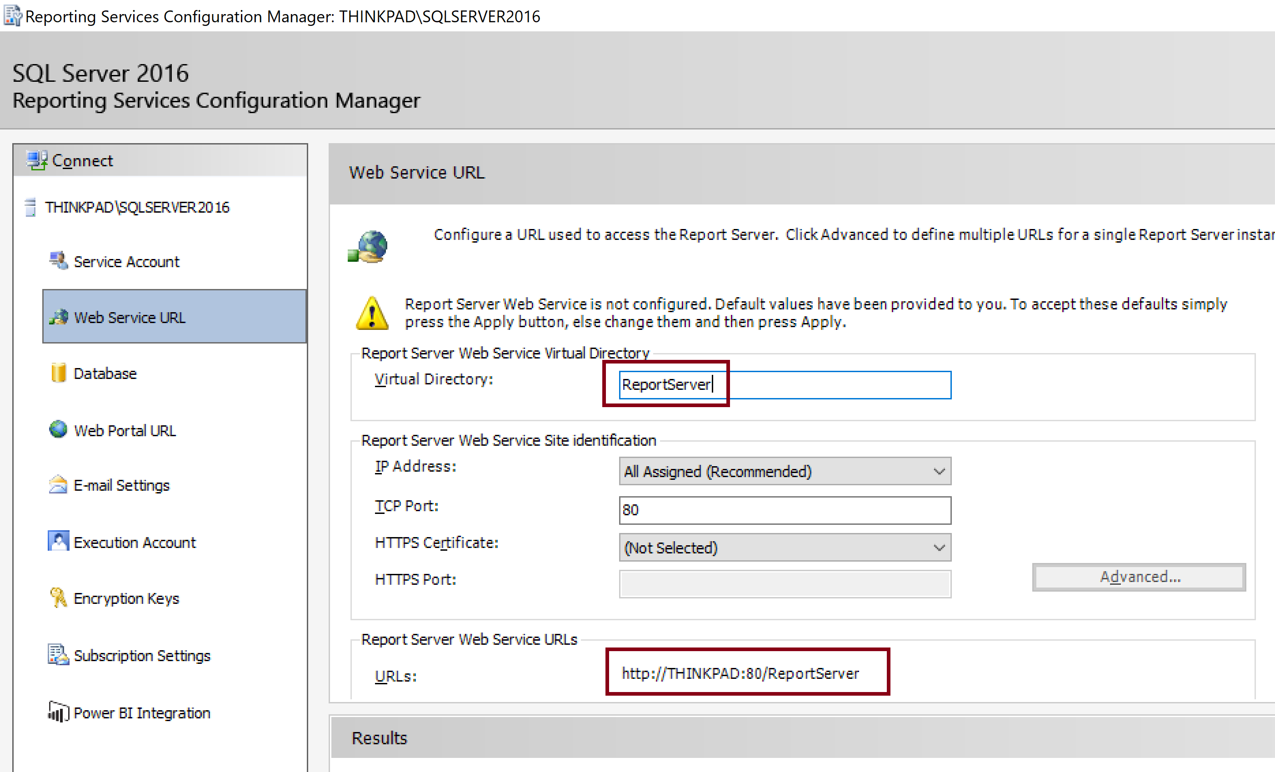
3. Enter Web Service URL
http://localhost/ReportServer
This service is used for deploying reports.

Slide 10
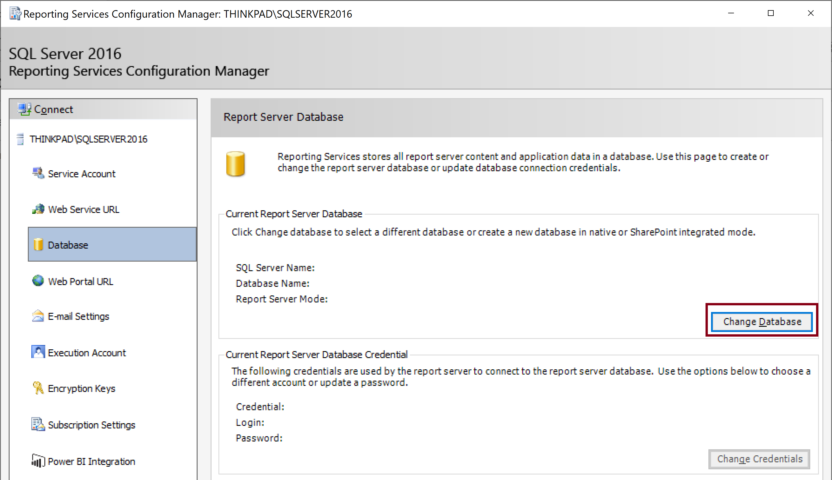
4. Change Report Server Database

Slide 11
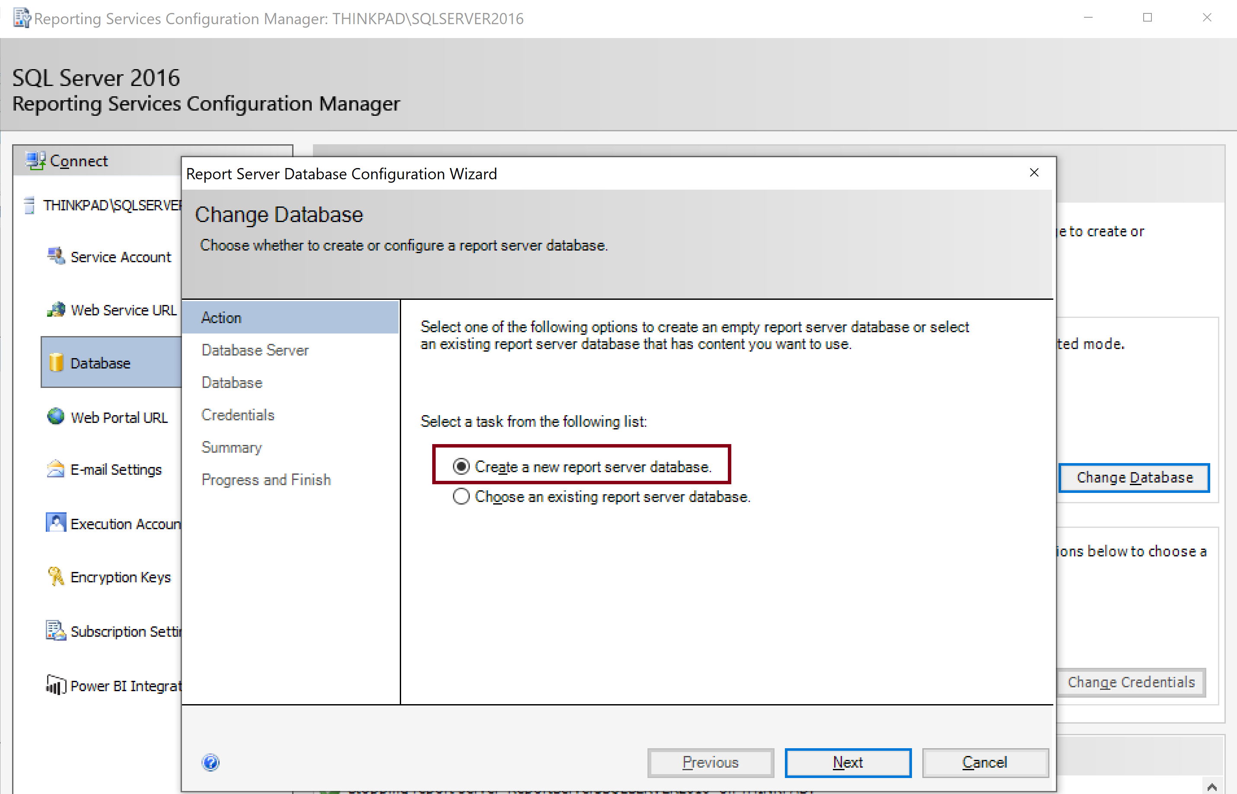
5. Create a New Report Server Database

Slide 12
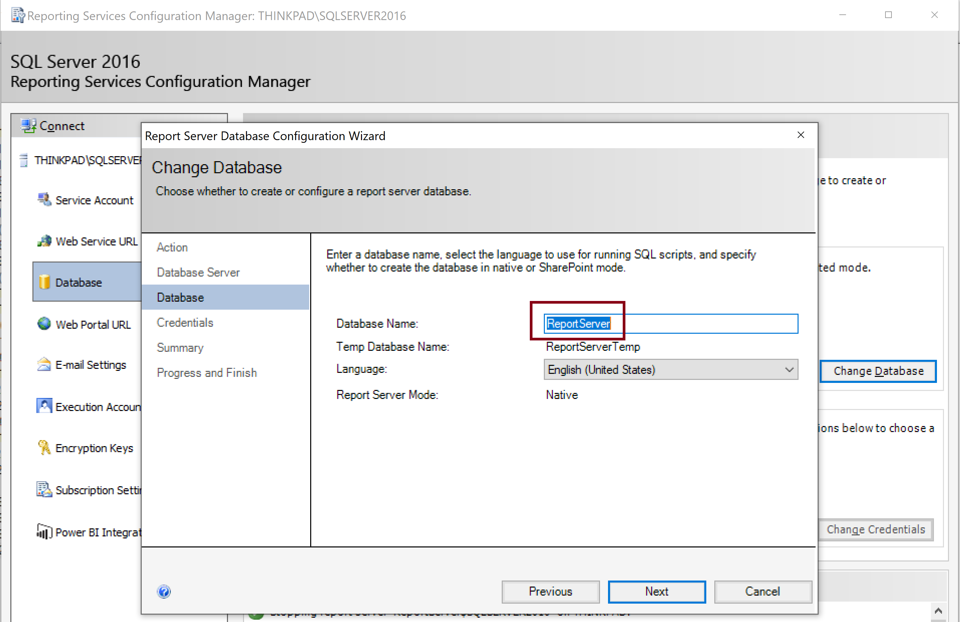
6. Enter Database Name
1
2

Slide 13
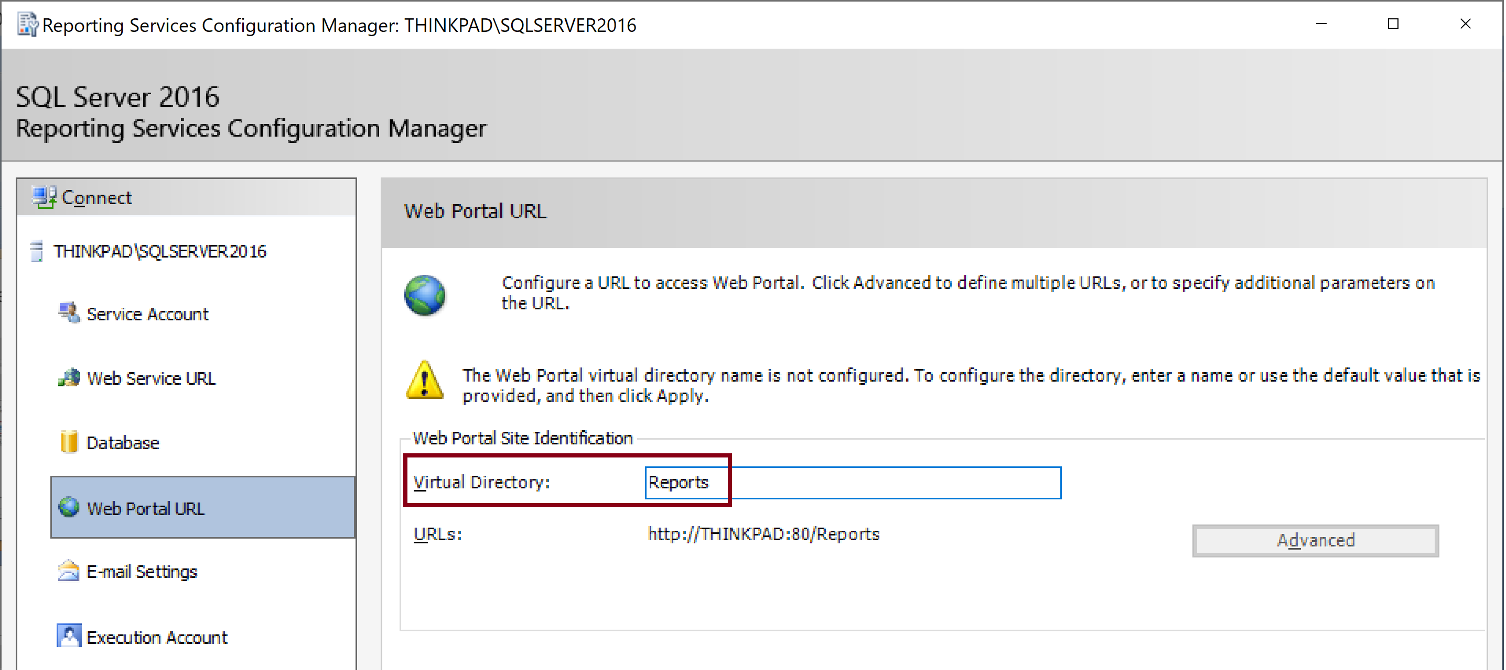
7. Enter Virtual Directory Name
2
1

Slide 14
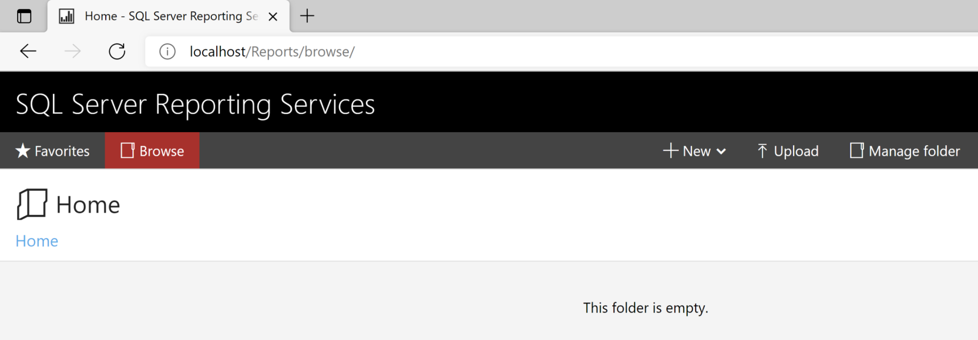
8. Test Web Portal URL
http://localhost/Reports/browse/

Slide 15


Slide 16
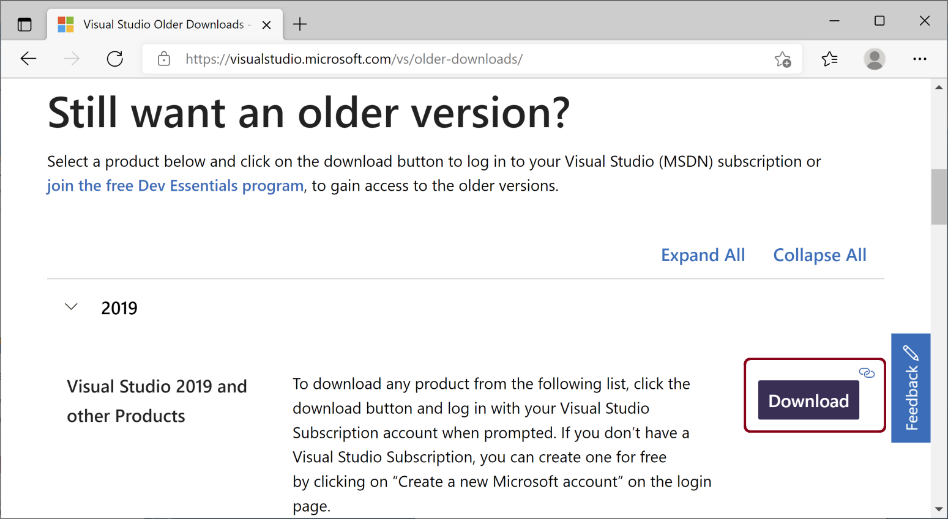
1. Download and Launch Visual Studio Professional 2019 Installer
https://visualstudio.microsoft.com/vs/older-downloads/ (please scroll down to the “Still want an older version?” section).

Slide 17
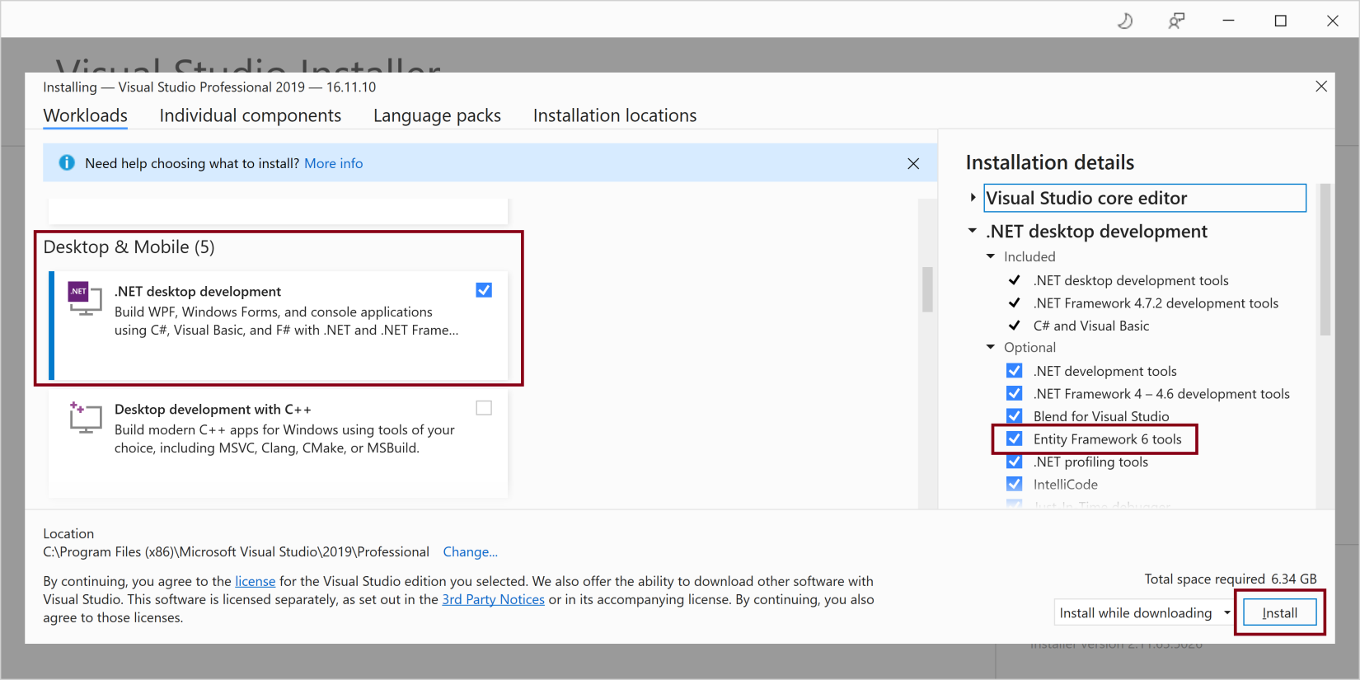
2. Select .NET desktop development and Entity Framework 6 Tools.
This screen applies only to Visual Studio 2019.

Slide 18
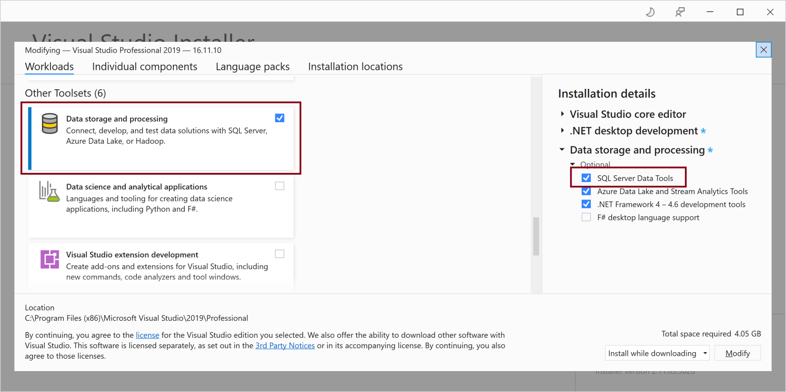
3. Select Data storage and processing and SQL Server Data Tools
This screen applies only to Visual Studio 2019.

Slide 19
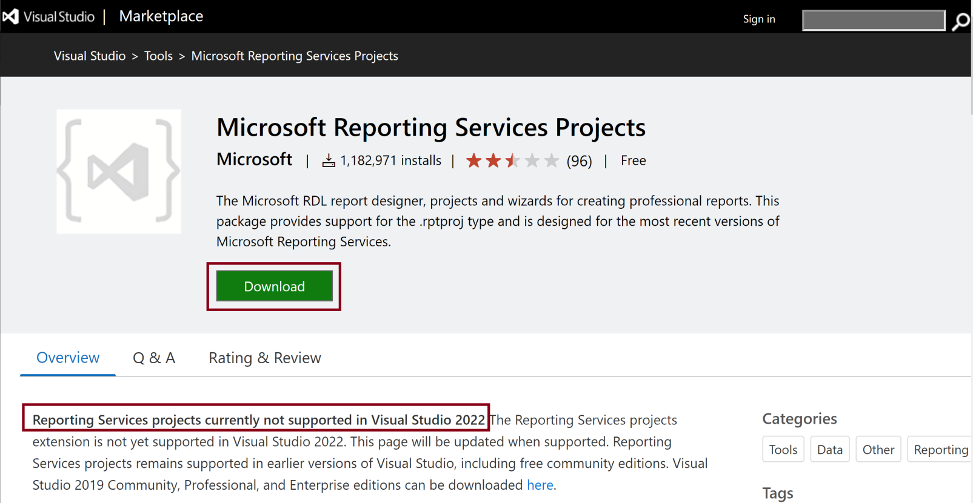
4. Download Microsoft Reporting Services Projects
https://marketplace.visualstudio.com/items?itemName=ProBITools.MicrosoftReportProjectsforVisualStudio

Slide 20
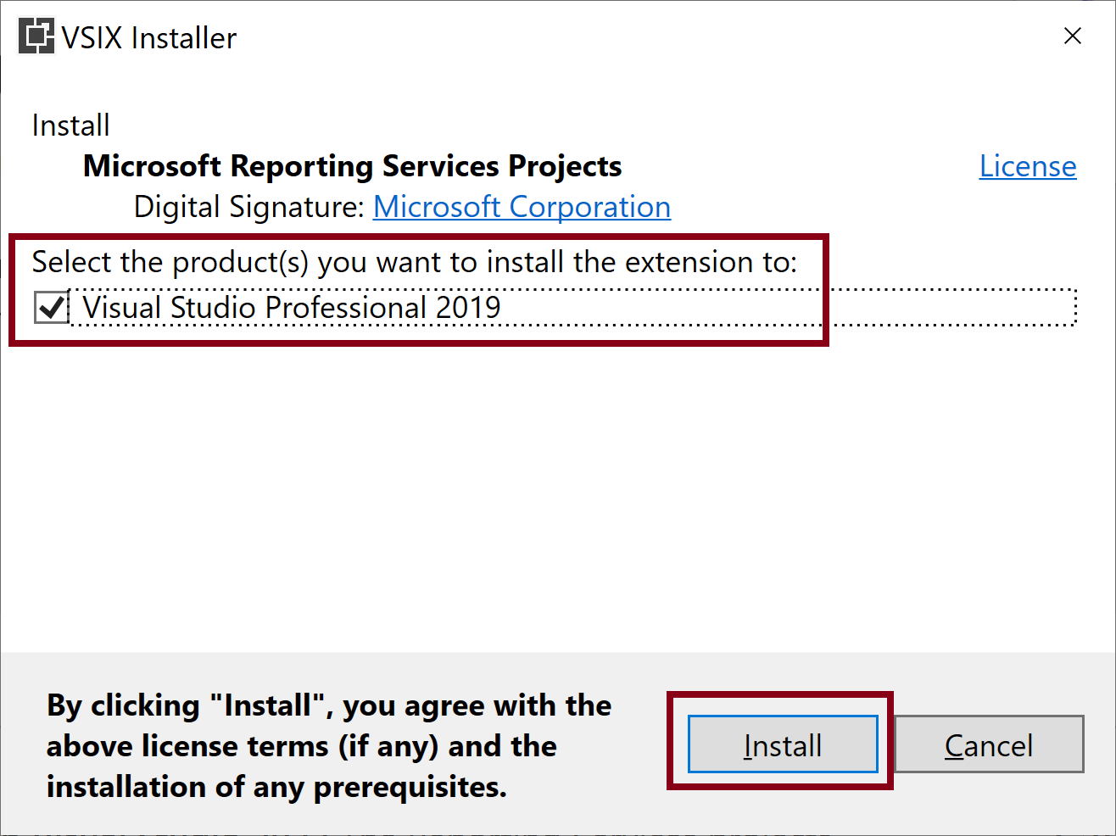
5. Install Microsoft Reporting Services Projects

Slide 21
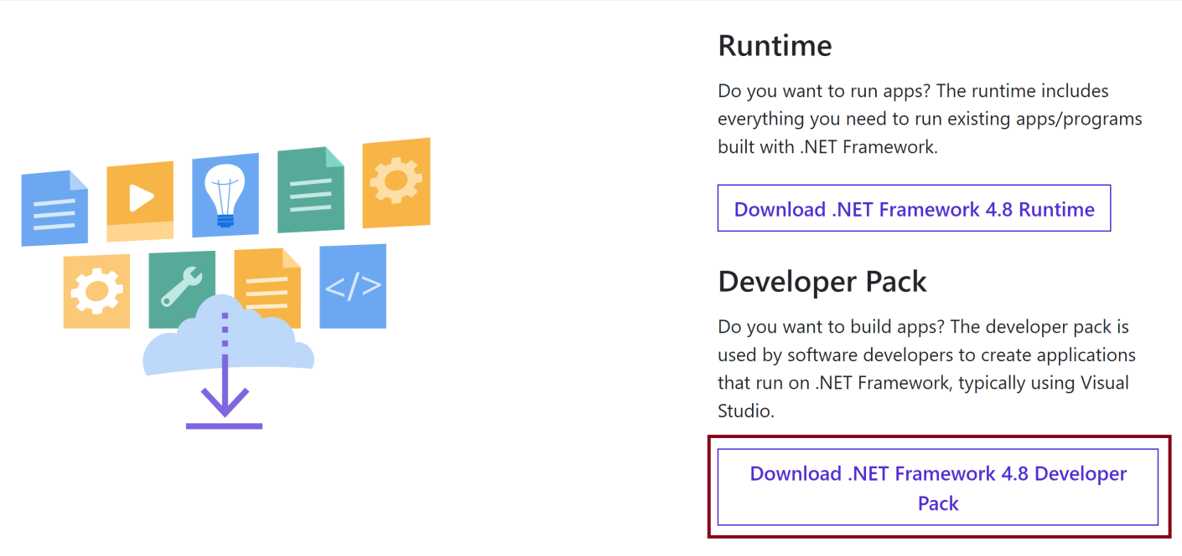
6. Download and Install .NET Framework for Developers version 4.8
https://dotnet.microsoft.com/en-us/download/dotnet-framework/net48 (please scroll down to the “Developer Pack” section).

Slide 22

Thank You & See You Again

